Slide 1
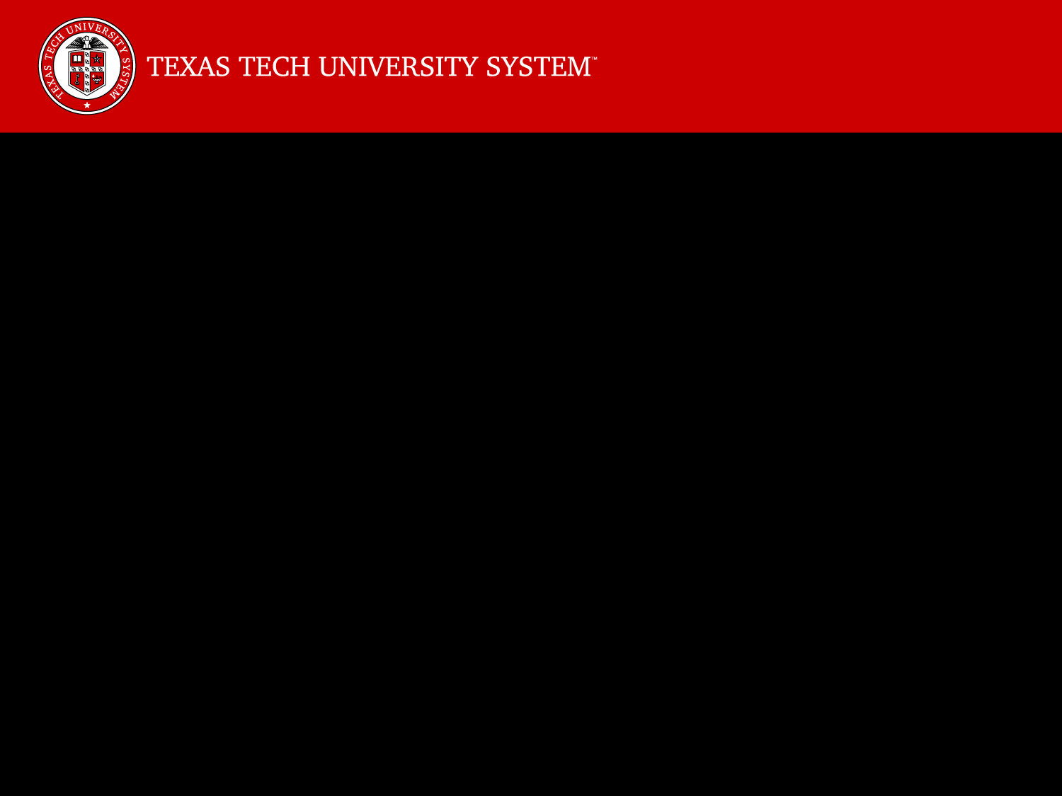
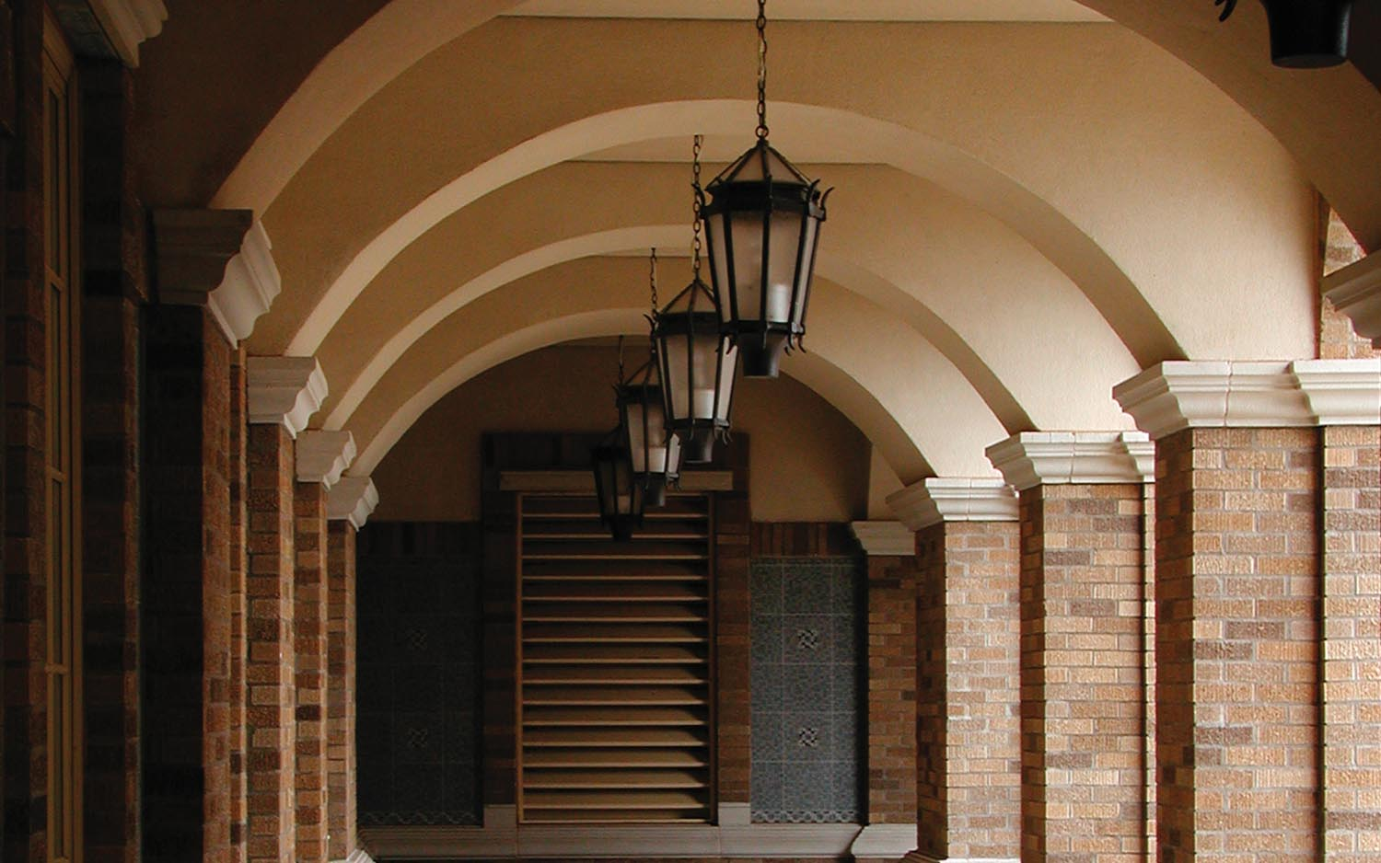
Image Inpainting
Abdullah Al Masud, Dong Guo, Siyuan Jiang

Slide 2
Image Inpainting
Image inpainting is the process of filling in the missing
properties of damaged image based on the information
of the intact part of the image. This technique is often
used to remove unwanted objects from an image or to
restore damaged portions of old photos.
Application of image inpainting:
Restoration of old photographs and damaged film,
Removal of superimposed texts,
Removal of objects .

Slide 3
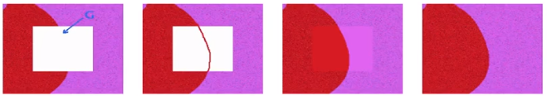
Objective:
The purpose of our project is to introduce a novel algorithm for image inpainting that attempts to replicate the basic techniques used by professional restorators. The basic idea is to smoothly propagate information from the surrounding areas in the isophotes direction. The user needs only to provide the region to be inpainted, the rest is automatically performed by the algorithm.
Figure 1: Basic inpainting technique used by professional restorators

Slide 4
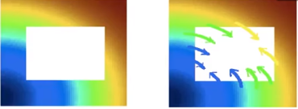
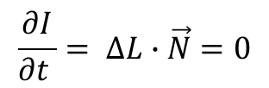
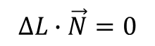



$$ΔL∙\vec{N}=0$$
$$\frac{∂I}{∂t }= ΔL∙\vec{N}=0$$
L = smoothness estimator (Laplacian)
N = isophote direction (time variant)

Slide 5
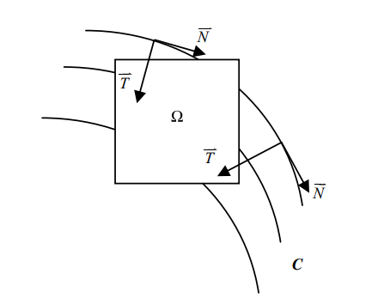
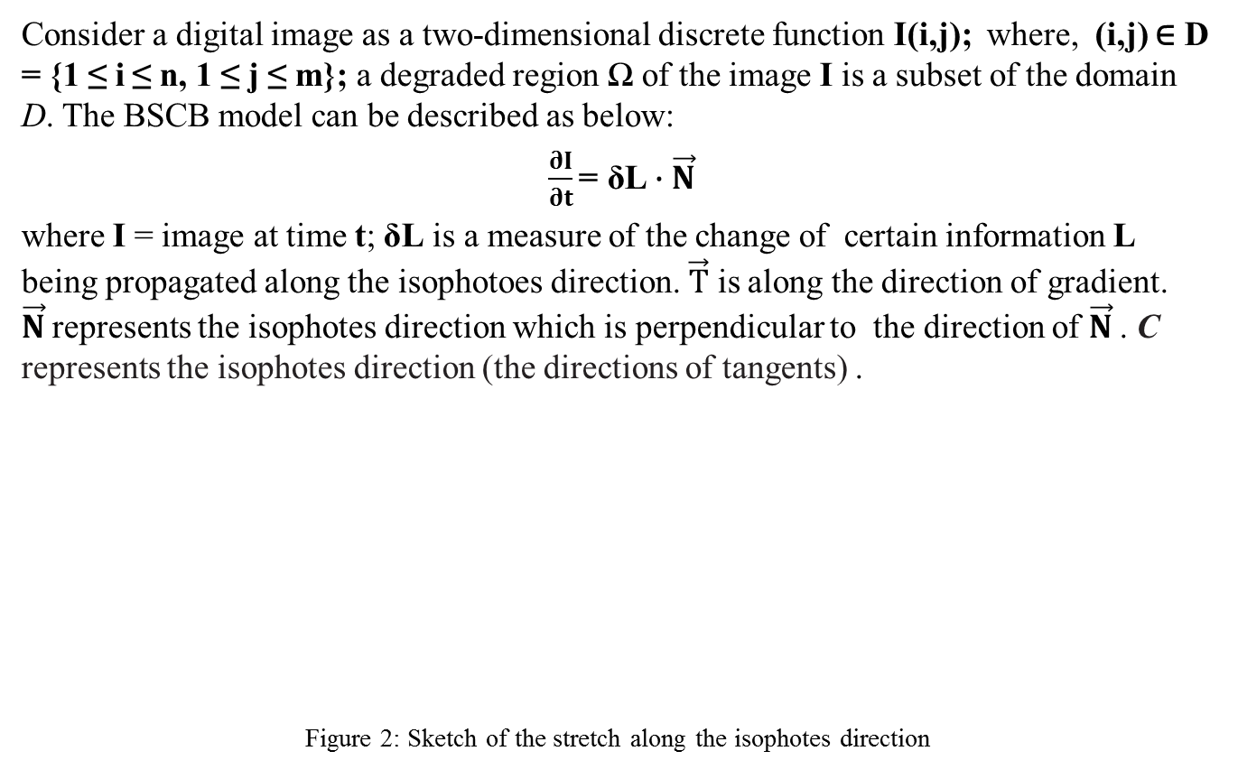
BSCB Inpainting Algorithm:
Consider a digital image as a two-dimensional discrete function I(i,j); where, (i,j) ∈ D = {1 ≤ i ≤ n, 1 ≤ j ≤ m}; a degraded region Ω of the image I is a subset of the domain D. The BSCB model can be described as below:
$\frac{∂I}{∂t}\text{= }\text{δL}∙\vec{N}$
where I = image at time t; δL is a measure of the change of certain information L being propagated along the isophotoes direction. $\vec{T}$ is along the direction of gradient. $\vec{N}$represents the isophotes direction which is perpendicular to the direction of $\vec{N}$. C represents the isophotes direction (the directions of tangents) .
Figure 2: Sketch of the stretch along the isophotes direction

Slide 6
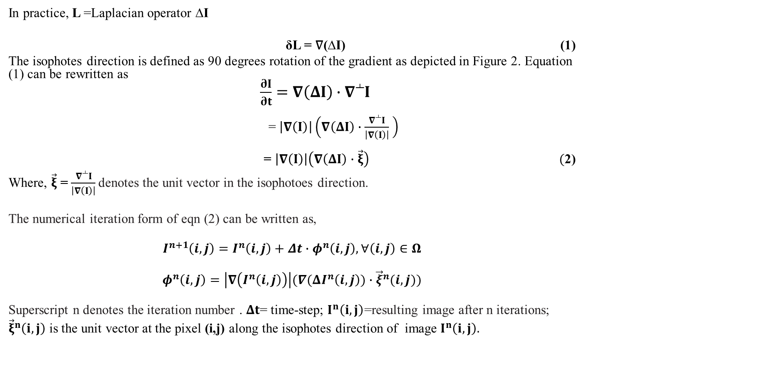
BSCB Inpainting Algorithm (Cont’d):
In practice, L =Laplacian operator ∆I
δL = ∇(∆I) (1)
The isophotes direction is defined as 90 degrees rotation of the gradient as depicted in Figure 2. Equation (1) can be rewritten as
$\frac{∂I}{∂t}=∇\left(ΔI\right)∙∇^{┴}I$
= $\left|∇\left(I\right)\right|\left(∇\left(ΔI\right)∙\frac{∇^{┴}I}{\left|∇\left(I\right)\right|} \right)$
= $\left|∇\left(I\right)\right|\left(∇\left(ΔI\right)∙\vec{ξ}\right) ($2)
Where, $\vec{ξ}$ = $\frac{∇^{┴}I}{\left|∇\left(I\right)\right|}$denotes the unit vector in the isophotoes direction.
The numerical iteration form of eqn (2) can be written as,
$$I^{n+1}\left(i,j\right)=I^{n}\left(i,j\right)+Δt∙φ^{n}\left(i,j\right), ∀\left(i,j\right)∈Ω$$
$$φ^{n}\left(i,j\right)=\left|∇\left(I^{n}\left(i,j\right)\right)\right|(∇(ΔI^{n}\left(i,j\right))∙{\vec{ξ}}^{n}(i,j))$$
Superscript n denotes the iteration number . $Δt$= time-step; $I^{n}\left(i,j\right)$=resulting image after n iterations;
${\vec{ξ}}^{n}\left(i,j\right)$ is the unit vector at the pixel (i,j) along the isophotes direction of image $I^{n}\left(i,j\right).$
Reference: Zeng, C., & Wang, M. (2009). Fast Convergent Image Inpainting Method Based on BSCB Model. Journal of Algorithms & Computational Technology,3(3), 331-341. doi:10.1260/174830108788251782

Slide 7
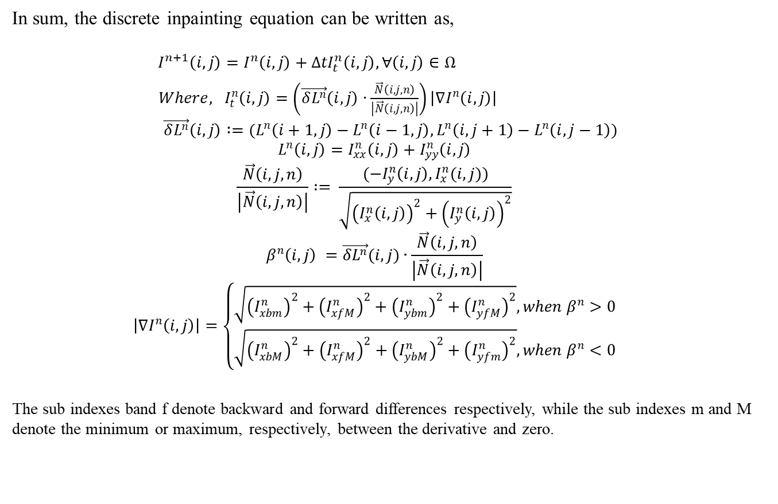
BSCB Inpainting Algorithm (Cont’d):
In sum, the discrete inpainting equation can be written as,
${ I}^{n+1}\left(i,j\right)=I^{n}\left(i,j\right)+{∆tI}_{t}^{n}\left(i,j\right), ∀\left(i,j\right)∈Ω$
${Where, I}_{t}^{n}\left(i,j\right)=\left(\vec{δL^{n}}\left(i,j\right)∙\frac{\vec{N}\left(i,j,n\right)}{\left|\vec{N}\left(i,j,n\right)\right|}\right)\left|∇I^{n}\left(i,j\right)\right|$
$$\vec{δL^{n}}\left(i,j\right) :=(L^{n}\left(i+1,j\right)−L^{n}\left(i−1,j\right),L^{n}\left(i,j+1\right)−L^{n}\left(i,j−1\right))$$
$$L^{n}\left(i,j\right)=I_{xx}^{n}\left(i,j\right)+I_{yy}^{n}\left(i,j\right)$$
$$\frac{\vec{N}\left(i,j,n\right)}{\left|\vec{N}\left(i,j,n\right)\right|} := \frac{(−I_{y}^{n}\left(i,j\right),I_{x}^{n}(i,j))}{\sqrt{{\left(I_{x}^{n}\left(i,j\right)\right)}^{2}+{\left(I_{y}^{n}\left(i,j\right)\right)}^{2}}}$$
$$β^{n}\left(i,j\right) =\vec{δL^{n}}(i,j)∙\frac{\vec{N}\left(i,j,n\right)}{\left|\vec{N}\left(i,j,n\right)\right|}$$
$$\left|∇I^{n}\left(i,j\right)\right|=\left\{\begin{aligned}\sqrt{{\left(I_{xbm}^{n}\right)}^{2}+{\left(I_{xfM}^{n}\right)}^{2}+{\left(I_{ybm}^{n}\right)}^{2}+{\left(I_{yfM}^{n}\right)}^{2}}, when β^{n}>0 \\ \sqrt{{\left(I_{xbM}^{n}\right)}^{2}+{\left(I_{xfM}^{n}\right)}^{2}+{\left(I_{ybM}^{n}\right)}^{2}+{\left(I_{yfm}^{n}\right)}^{2}}, when β^{n}<0\end{aligned}\right.$$
The sub indexes band f denote backward and forward differences respectively, while the sub indexes m and M denote the minimum or maximum, respectively, between the derivative and zero.
Reference: Bertalmio, M., Sapiro, G., Caselles, V., & Ballester, C. (2005). Image Inpainting. doi:10.21236/ada437378

Slide 8
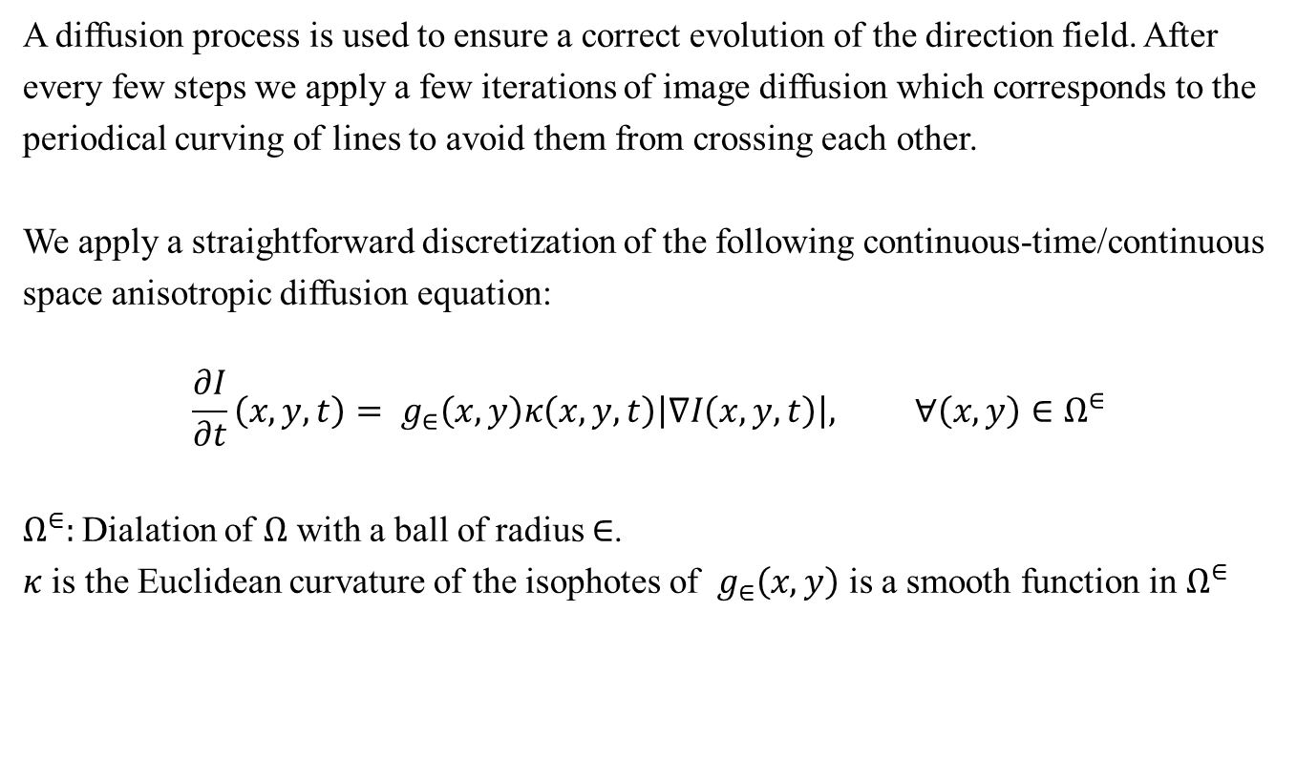
BSCB Inpainting Algorithm (Cont’d):
A diffusion process is used to ensure a correct evolution of the direction field. After
every few steps we apply a few iterations of image diffusion which corresponds to the
periodical curving of lines to avoid them from crossing each other.
We apply a straightforward discretization of the following continuous-time/continuous
space anisotropic diffusion equation:
$$\frac{∂I}{∂t}\left(x,y,t\right)= g_{∈}\left(x,y\right)κ\left(x,y,t\right)\left|∇I\left(x,y,t\right)\right|, ∀\left(x,y\right)∈Ω^{∈}$$
$Ω^{∈}:$Dialation of $Ω$ with a ball of radius $∈$.
$κ$ is the Euclidean curvature of the isophotes of $g_{∈}\left(x,y\right)$ is a smooth function in $Ω^{∈}$

Slide 9
Flow Chart of the Algorithm:
Start
Read the image
Read the mask
Is image grey scale?
Process the grayscale image with mask
yes
Is time scale divisible by 15?
no
Process the RGB image with mask
yes
no
Impaint the image using PDE
Diffuse the image
End

Slide 10

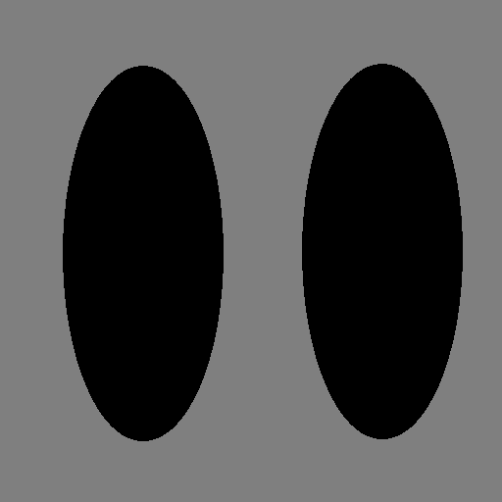
Results:
Figure 3: Synthetic example

Slide 11
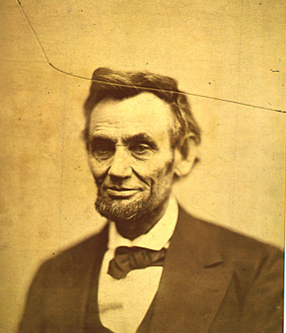
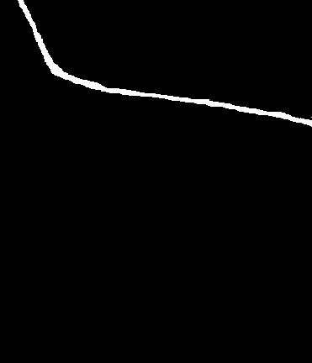
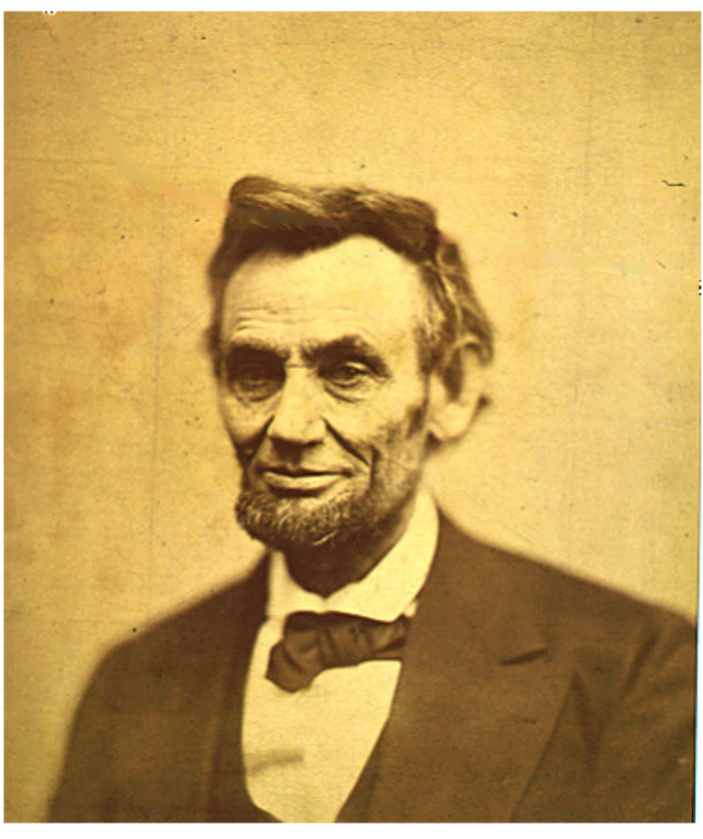
Results:
Restoration of old photograph:
Old photograph
Mask
After inpainting

Slide 12
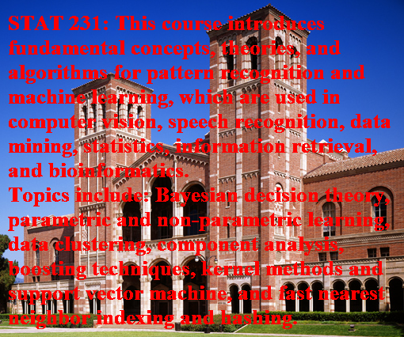
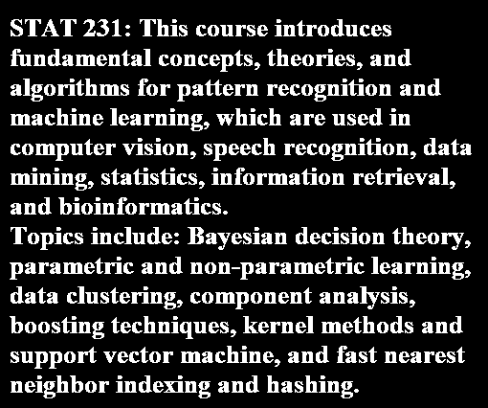
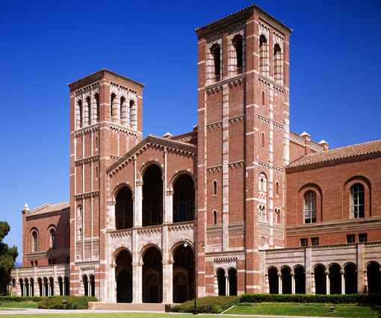
Removal of superimposed texts
Results:
Original image
Mask
After inpainting

Slide 13
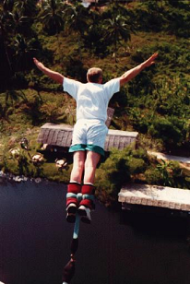

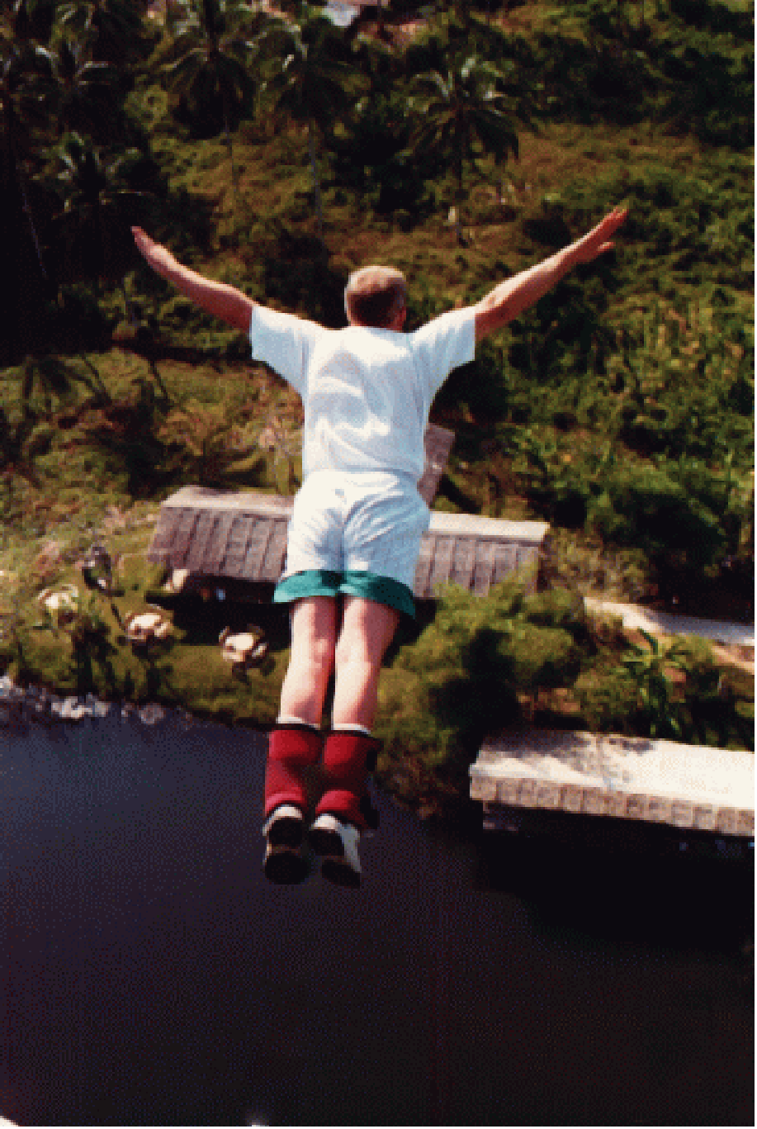
Removal of object
Results
Original image
Mask
After inpainting

Slide 14
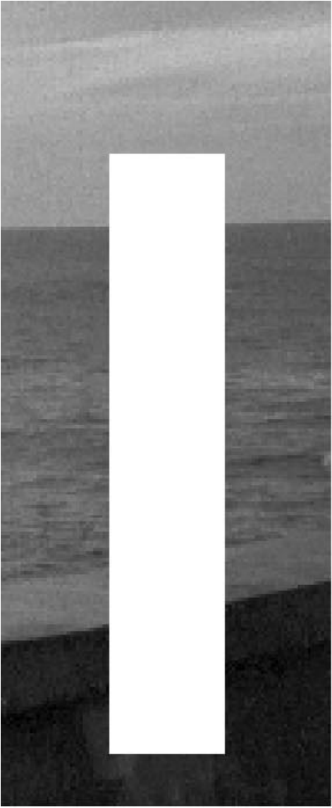
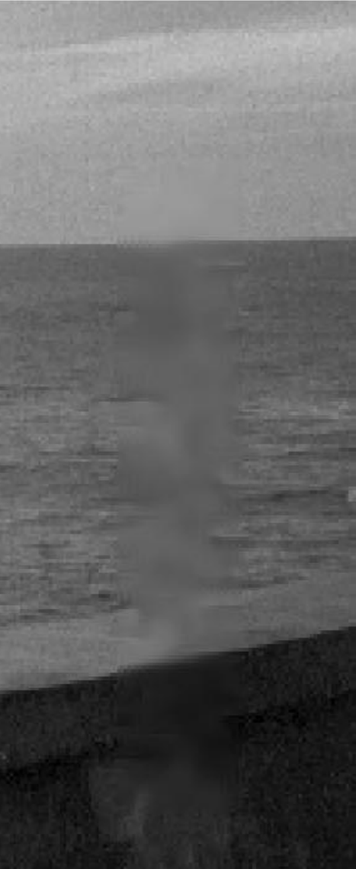
Limitations
1. Proposed algorithm is one of the basic inpainting algorithm, it works fine for small inpainting region and cartoon image, but it fails to inpaint large inpainting region and textured image. Also it may produce blurred resulting image.
Figure 4: Limitations of the algorithm: texture is not reproduced
2. Computation time is higher comparing to recent inpainting techniques (for example: Fast convergent image inpainting method).

Slide 15
References:
[1] Bertalmio, M., Sapiro, G., Caselles, V., & Ballester, C. (2005). Image Inpainting. doi:10.21236/ada437378
[2] Zeng, C., & Wang, M. (2009). Fast Convergent Image Inpainting Method Based on BSCB Model. Journal of Algorithms & Computational Technology,3(3), 331-341. doi:10.1260/174830108788251782
[3] Tapan Kumar Hazra1, Rajashree Mitra, , Jayashree Bhattacharya (2013). A Comparative Study of Bertalmio and Exemplar Based Image Inpainting. International Journal of Science and Research

Slide 16


